Slide 1
Novel Computer Vision and Machine Learning techniques
for enhanced protection of water infrastructures
N. Bakalos, M. Bimpas, A. Doulamis, A.Voulodimos,
D. Ayala-Cabrera
Institute of Communication and Computer Systems
stop-it-project.eu

Slide 2
Toolkit to protect against physical threats
STOP-IT Project develops a number of tools for protecting water infrastructures against physical and cyber threats.
Such technological tools need to meet some basic requirements:
  Leverage multiple information modalities – Leverage the complementarity of various systems.
  Learn effective representations of complex heterogeneous data.
  be able to adapt to the dynamic nature of sophisticated threats and readjust accordingly.

Slide 3
Proposed solution
Design a close-loop system between an analyst intuition and machine intelligence to detect anomalous behaviour.
  Use of deep learning and other schemes to identify key patterns within potential threats, generating a pattern library to support future analysis.
  Keep suspicious behaviour under a quarantine until a analyst validates the sample.

Slide 4
Proposed solution – Task 5.3
Smart locks Access control system.
Coordinated network of cameras, for immediate identification of intrusion/abnormal movements/behaviour around the CI.
XACML Authorization Engine (physical access control to areas and resources system).
WiFi signals reflections on human bodies.
Water quality monitoring technologies for the early detection and impact minimization of contamination events (intentional attacks).
Notes:
Smart locks Access control system, based on intelligent electronic locks, and dedicated applications to service employees and to central management system. Electric gates control via a secured cellular controller, interfacing an access control system. Preventive maintenance management of electronic shielding switchboards and electronic locks.
- Coordinated network of cameras, for immediate identification of intrusion/abnormal movements/behaviour around the CI by using improved computer vision techniques. CIP addresses current difficulties by researching on new computer vision tools able to (i) detect unexpected humans’ action without being previously trained on them (ii) operate under unconstrained visual conditions and (iii) demand low computational cost.
- XACML Authorization Engine: fine-grain physical access control to areas and resources system. This component is a service oriented attribute-based access control mechanism that employs user specified policies to determine who can access which resources and for what purpose.
- WiFi signals reflections on human bodies to detect their presence for intruders. By analysing the reflection of WiFi signals in human body, it is possible to detect the presence of persons in a room or corridor. At this moment, a prototype has been implemented, which performs very well, with a success rate above the 90%.
- Water quality monitoring technologies for the early detection and impact minimization of contamination events (intentional attacks). An optimization-simulation framework is applied using measurements provided by quality sensors placed at strategic placements. The issue associated with the validation / calibration of the corresponding quality sensors are also addressed.

Slide 5
Proposed solution – Task 5.3
Task 5.3 – vision part. Physical
Notes:
Adaptive TDL-CNN: Tapped Delay Line – Convolutional Neural Network
Prototype Matlab,
Python

Slide 6
Identification of abnormal behavior from a coordinated network of cameras
Objectives
Identification of unusual behavior based on data from surveillance cameras.
Detect unusual actions without being previously trained to them.
Operate under constrained visual conditions.
Demand low computational resources.
Notes:
Demand low computational resources:

Slide 7
Identification of abnormal behavior from a coordinated network of cameras
Tracking
Extract a set of visual descriptors
  Invariant to translation, rotation and scaling
  (e.g. SIFT, SURF, ORB)*.
Apply bags of visual words (RANSAC scheme refined)
  remove potential outliers.
Enhance the outliers with appearance models to identify objects across disjoint network of cameras.
A probabilistic framework will be exploited to track the objects.
*SIFT: Scale-invariant feature transform
SURF: Speeded up robust features
ORB: Oriented fast and Rotate Brief.
Notes:
SIFT: Scale-invariant feature transform
SURF: Speeded up robust features
ORB: Oriented fast and Rotate Brief.

Slide 8
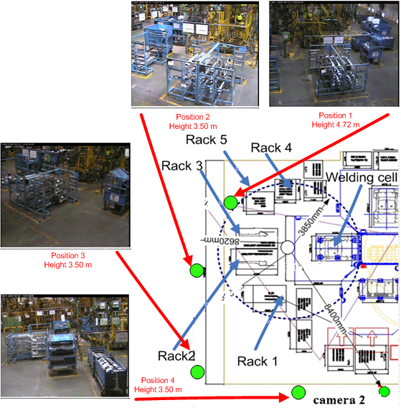
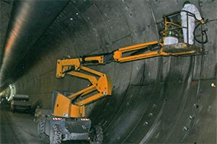
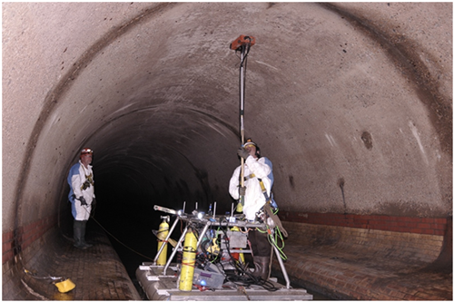
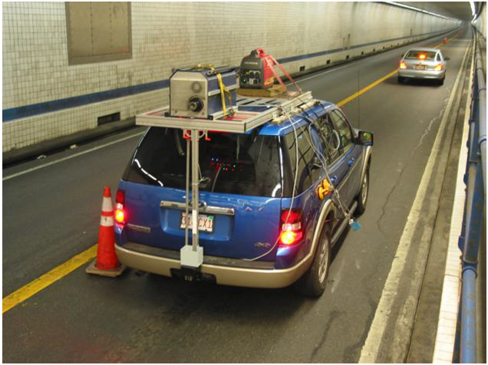
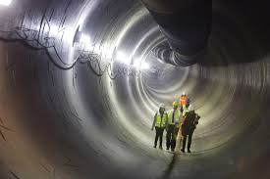
Identification of abnormal behavior from a coordinated network of cameras
Similar implementations
Visual representation
of industrial content
Tunnel Crack
Detection
Maritime Surveillance

Slide 9
Identification of abnormal behavior from a coordinated network of cameras
Usual infrastructure includes RGB and Thermal cameras.
The topology of the camera network affects performance and the ability to contextualize the spatial information.
  Overlapping cameras: you can keep track of the entirety of an object’s route.
  Disjointed network of cameras: only parts of the route is available.
Data preprocessing is useful in order to feed the Machine Learning (ML) tools with semantic information rather than raw data

Slide 10
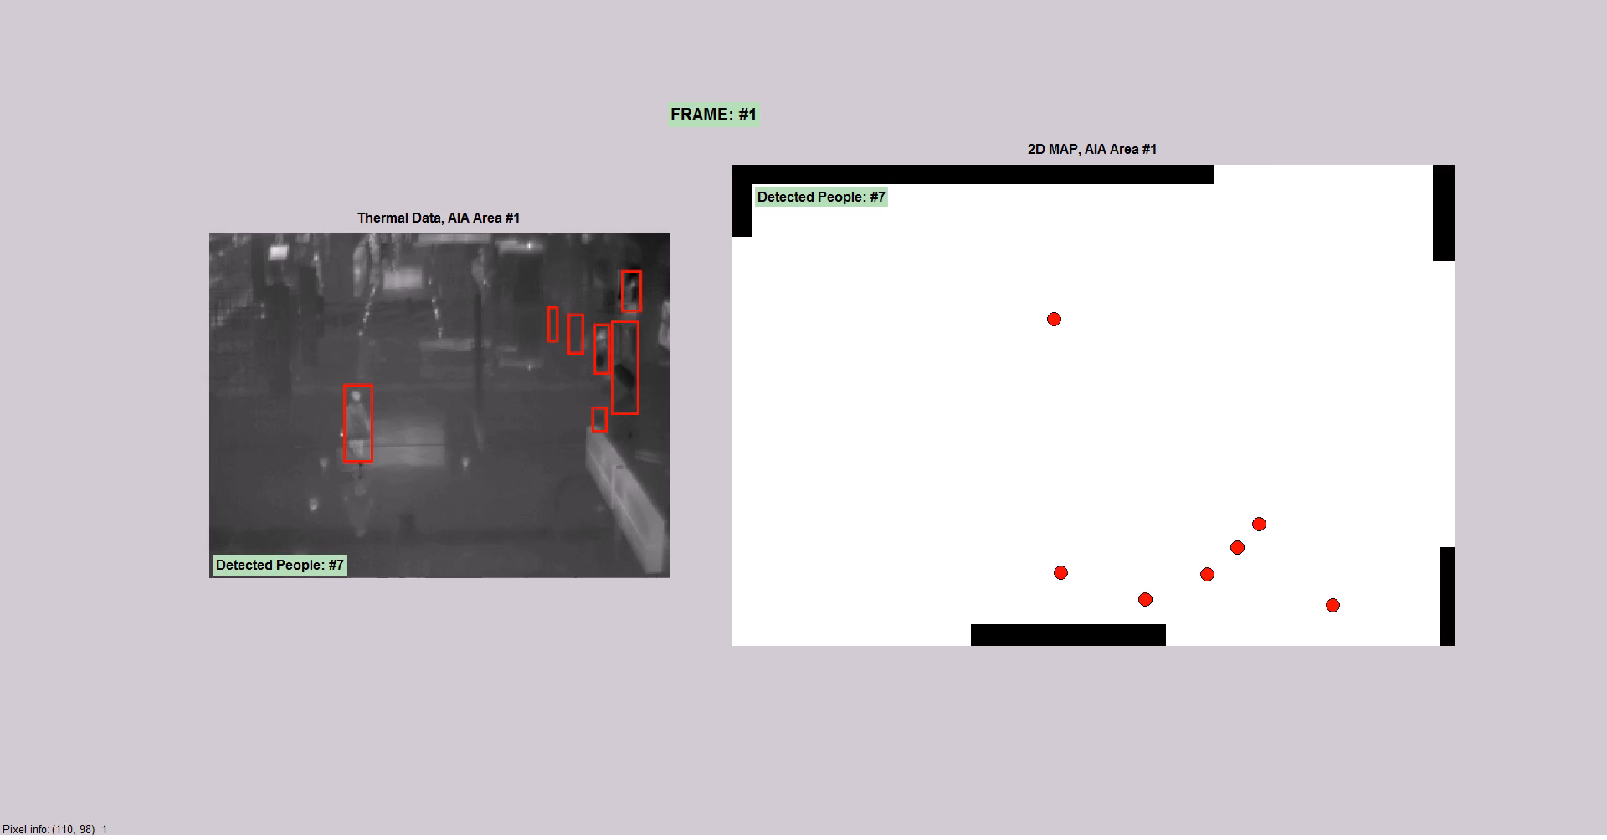
Identification of abnormal behavior from a coordinated network of cameras
Tracking on an Overlapping network of cameras
Notes:
Extract a set of visual descriptors
Invariant to translation, rotation and scaling
e.g. SIFT, SURF, ORB
Apply bags of visual words (RANSAC scheme refined)
remove potential outliers.
Enhance the outliers with appearance models to identify objects across disjoint network of cameras
A probabilistic framework will be exploited to track the objects.

Slide 11
Identification of abnormal behavior from a coordinated network of cameras
Data preprocessing
Heavily affected by the data modality (RGB or Thermal).
Need to identify techniques that can enrich raw data with semantic information without seriously hindering the performance.

Slide 12
Identification of abnormal behavior from a coordinated network of cameras
Data preprocessing - RGB
Object detection algorithms can provide semantic information in real time.
Can identify areas of interest and reduce the dimensionality of the problem.
YOLO V3 algorithm
Notes:
YOLO V3 algorithm: You Only Look Once v3

Slide 13
Identification of abnormal behavior from a coordinated network of cameras
* Y. Zhao, H. Shi, X. Chen, X. Li and C. Wang, "An overview of object detection and tracking," 2015 IEEE International Conference on Information and Automation, Lijiang, 2015, pp. 280-286.
URL: http://ieeexplore.ieee.org/stamp/stamp.jsp?tp=&arnumber=7279299&isnumber=7279248

Slide 14
Identification of abnormal behavior from a coordinated network of cameras
Data preprocessing - Thermal
Object detection is much more difficult
  No texture information.
  Objects are not homogeneous in temperature.
Background subtraction algorithms can provide similar services without hindering performance.
Notes:
Variatonal Inference Algorithm based on a Gaussian Mixture Modelling

Slide 15
Identification of abnormal behavior from a coordinated network of cameras
Object Detection (RGB)
Pros
Can identify specific objects
Can efficiently track the route of the object
Multi-class classification
Cons
Only a realistic choice for RGB cameras
Based on the granularity of the analysis can prove computationally demanding
Have been trained based on generic datasets
Background Subtraction (Thermal)
Pros
Computationally efficient
Suitable for thermal cameras
Can be trained easily to reflect field specific issues
Data driven
VS
Cons
Only two classes (background or foreground object)
Cannot track the route of specific objects
Provides general semantic information (essentially helps to disregard the background in the analysis)

Slide 16
Identification of abnormal behavior from a coordinated network of cameras
Background Subtraction
Visual Result on test datasets
Notes:
OSU: is Ohio state university
AIA: Athens international airport

Slide 17
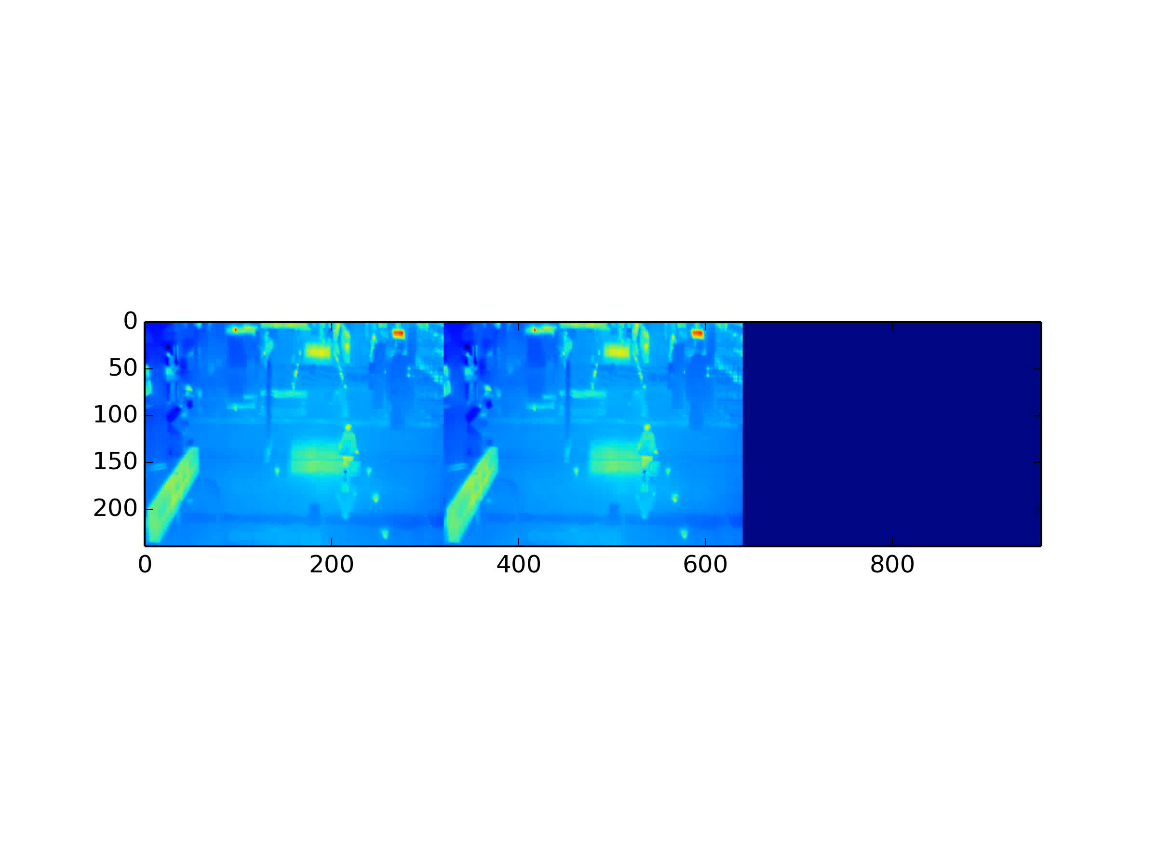
Identification of abnormal behavior from a coordinated network of cameras
Background Subtraction

Slide 18
Benefits of the approach
With the machine learning (ML) approach we are looking to improve the performance on:
Use and explore data from many fields.
Reduce the amount of false positives.
Improve the performance using an analyst.
Using algorithms which have different ways to find anomalies (supervised, no supervised) will improve the overall results.

Slide 19
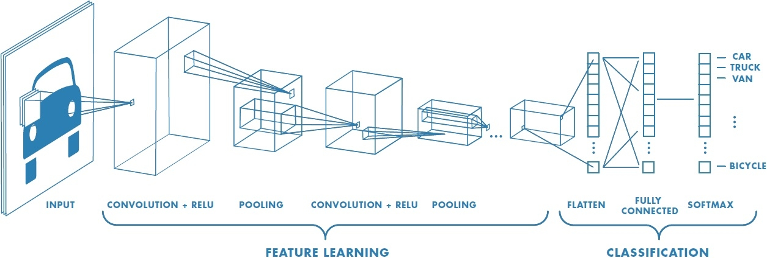
Convolutional neural networks: an automated feature extraction process
Feature Learning:
  We cut the original image in smaller ones, called image patches
  Each patch is multiplied with a predefined matrix, called kernel
  The result (a smaller patch in size) is further subsampled
  We may repeat steps 1-3 for the generated image patch
Such an approach summarize all the information of a patch into a feature vector
Classification:
  A typical FFNN uses the feature vector values as inputs and predicts the belonging class of the pixel at the center of the image patch.
CNNs are designed mainly for image processing applications
Notes:
RELU (activation function): rectified linear unit
FFNN: Feed Forward Neural Network

Slide 20
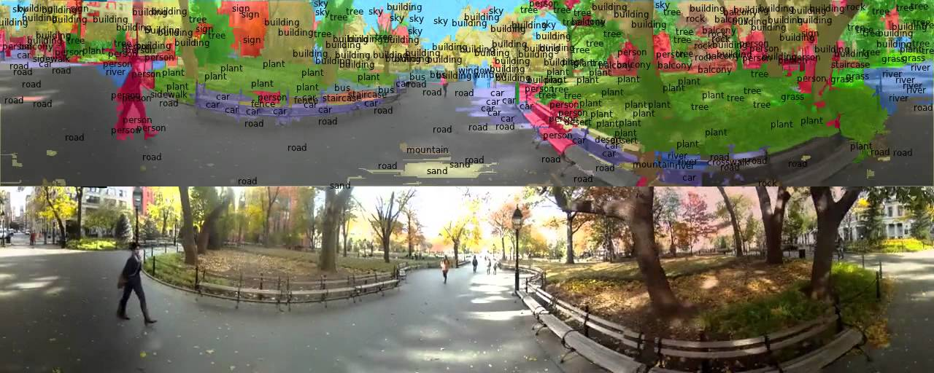
Convolutional neural networks: an illustration of a trained CNN

Slide 21
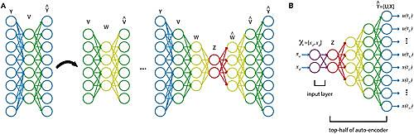
3rd compression layer
2nd compression layer
1st compression layer
Original Input
The idea: reducing the input space maintaining most of the available information.
It’s an unsupervised compression approach that battles the curse of dimensionality.
Stacked autoencoders: a non linear dimensionality reduction approach
Notes:
Another deep learning solution for classical problems.

Slide 22
Other classification methods
Traditional approaches
Advanced approaches
Logistic regression
A traditional method for various purposes
K-nearest neighbors
An object is classified by a majority vote of its neighbors
Classification trees
leaves represent class labels and branches represent conjunctions of features that lead to those class labels
Adaptive boosting
SVMs
Artificial neural networks
the examples of the separate categories are divided by a clear gap linear.
they are composed from multiple hierarchical layers of interconnected nodes
Combine many weak learners to produce a good one
Notes:
We have tested
K nearest neighbours, SVM (Linear and RBF Kernel), 2 different Feed Forward Neural Nets, Convolutional Neural Networks, TDL-CNN
With CNN and TDL-CNN we also used an adaptivity (feedback) function for fast retraining after a false positive is identified by the expert that mans the cameras

Slide 23
Identification of abnormal behavior from a coordinated network of cameras
Requirements for successful implementations
The adaptivity of the implementation is essential to ensure:
  Easy retraining of the system based on new captured data.
  Use the intuition of experts to adapt the behavior of the system and enhance performance.
Data: As with most data intensive application the use or large numbers of representative training data is imperative.

Slide 24
Identification of abnormal behavior from a coordinated network of cameras
Conclusions
STOP-IT develops various tools for protecting water infrastructures.
A rising frequency and sophistication of various types of cyber and physical attacks to critical water infrastructure creates a serious risk management gap, especially in small and medium sized water distribution and monitoring utilities.
Correct selection of features and preprocessing techniques can greatly enhance the accuracy of the tools.
Use of several modalities (Thermal, RGB, other) as input to the ML tools to identify complex behaviors.

Slide 25
THANK YOU FOR YOUR ATTENTION
stop-it-project.eu
David Ayala Cabrera. ICCS.
dayala32@gmail.com
Nikos Bakalos. ICCS.
bakalosnik@mail.ntua.gr
Manthos Bimpas. ICCS.
mbibas@iccs.gr

